Slide 1

Part 2: Creating the body of a 10-15 minute scientific presentation—Design/Methods; Data/Results; Conclusions
Notes:
Welcome to Part 2 of our CLIMB videos on creating a 10-15 minute scientific presentation

Slide 2
This the second of a two-part video sequence on a 10-15 minute scientific presentation
Part 1 – Creating an Introduction for a 10-15 minute scientific presentation
Focus on how to structure a brief introduction that sets the stage for the rest of your talk
Part 2 – Creating the body of a 10-15 minute scientific presentation—Design/Methods; Data/Results; Conclusions
Focus here is on the overall structure of the rest of the presentation
Note: the same patterns apply for a longer talk as well—there you expand the scope and/or apply the patterns to a succession of research questions
Notes:
This is the second of a two part series – Part 1 focused on creating and introduction that sets the stage for the talk…and in this video, the focus is on the overall structure of the rest of the presentation
Note that the same patterns can apply for longer talks – but in that case, you expand the scope or apply the patterns to a succession of research questions

Slide 3
Recall that we begin a presentation with the introductory CCQH pattern -- moving from “big picture” to well-defined problem/hypothesis
Context
  Context gives the big picture
Complication
  Complication tells us what’s unknown or uncertain about the issues raised by the context
Question
  The Question raised by the complication should be answerable in a way that will resolve the complication
Hypothesis
  The Hypothesis focuses not only the work itself but the presentation
This introductory rhetorical pattern is like a funnel – moving from the big/general to the narrow focus of the hypothesis

Slide 4
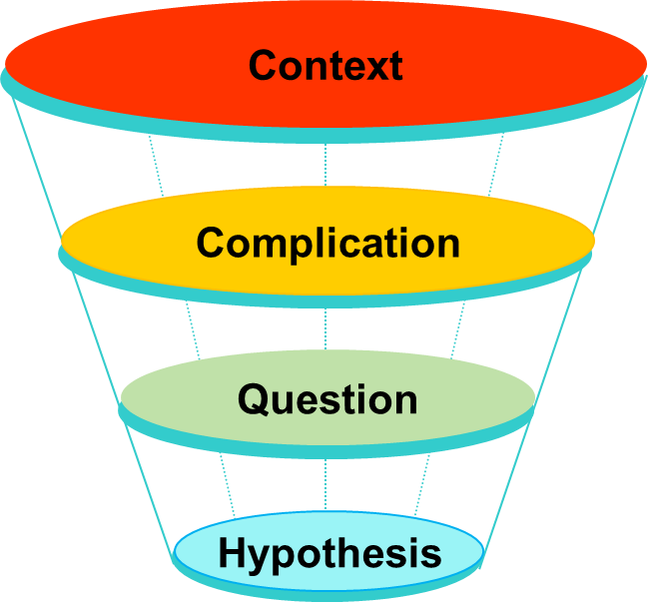
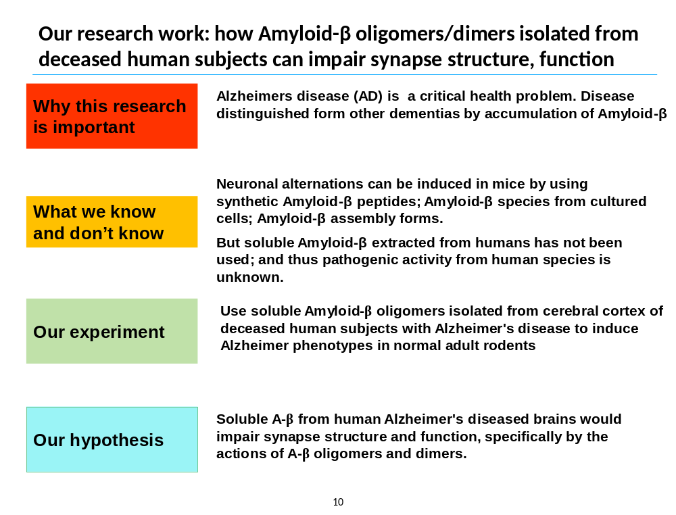
And recall how in Part 1 we applied the CCQH pattern to create an introductory slide for an actual neuroscience experiment

Slide 5
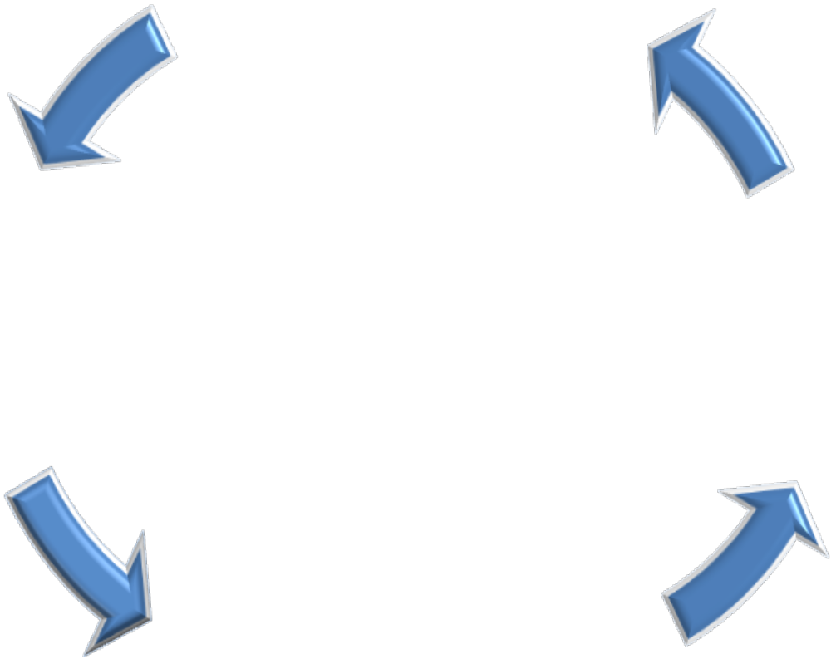
After the intro we need to create the other three components of the presentation – Design/Methods; Data/Results; Conclusions
Design
Methods
Conclusions
Data/Results

Slide 6
And Design/Methods can be divided into two components – Logical and Technical
Design
Methods
Conclusions
Logical
Technical
Data/Results

Slide 7
When designing individual slides about design/methods, keep categories sharply defined, move from broad to specific….and
Who is your audience?
What do they know?
What do they not know?
What do they need to know?
What do they NOT need to know?
…focus on
Let’s look at the example we used in the Part 1 Video:
Amyloid-β protein dimers isolated directly from Alzheimer's brains impair synaptic plasticity and memory. Nature Medicine. 2008 Aug. 14(8):837-42. Epub 2008 Jun 22.

Slide 8
Design/Methods in study using soluble Amyloid-β oligomers/dimers from deceased human subjects to induce AD in normal rodents
Brain tissue
collection
Extracted brain homogenates from 15 deceased humans with various confirmed dementias; 2 deceased subjects neurologically normal
Brain tissue preparation
Prepared three extracts (1) aqueously soluble TBS, (2) detergent-soluble TBS-TX and (3) 'insoluble' GuHCL extracts by sequential centrifugation and size exclusion chromatography
Brain tissue analysis
Used immunoprecipitation and western blotting protocol to detect Abeta in the TBS, TBS-TX and GuHCl extracts.
Used hippocampal slice electrophysiology recording to establish baseline, then perfused extracts and recorded LTP and LTD values
Performed passive avoidance conditioning
Conducted dendritic spine density analysis
Rodent experiments
Statistical
methods
Data from electrophysiology and passive avoidance experiments analyzed by one way ANOVA followed by Bonferroni post-hoc test
Dendritic spine morphology analyzed by one-way ANOVA with Tukey-Kramer’s correction

Slide 9
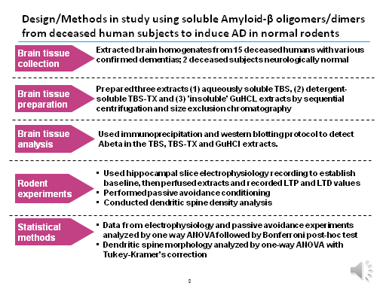
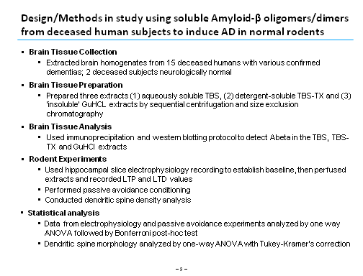
Note how this slide uses the horizontal qualities of PowerPoint – in effect, a word table rather than succession of bullet points
Word table format takes advantage of PowerPoint’s horizontal flow…
…While bullet points make you process words vertically, which is more appropriate for prose documents

Slide 10
The most critical thing to do is to create 2-3 word categories for each of your design items or method techniques
Brief categories
Note how this slide implies a Design and just addresses the technical components of Methods

Slide 11
Your Data/Results make up the bulk of your presentation; make sure they map on precisely to the methods you used to gather data
Levels of Abeta
Electrophysiology results
Passive avoidance results
Dendritic spine density analysis
Avoid the hazard of getting bogged down in data discussion – keep in mind that you should devote 1 to 1.5 minutes per slide

Slide 12
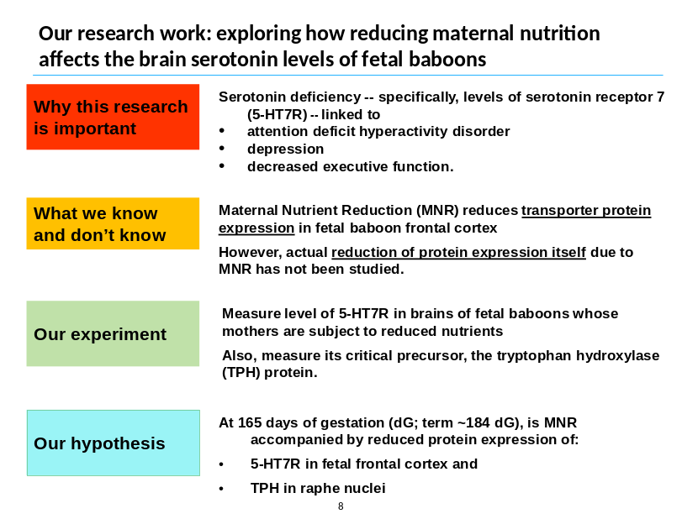
Finally conclusions should circle back to hypothesis: was hypothesis correct? If so why, if not in whole or part, why not? ONE SLIDE.
Conclusion: soluble Abeta oligomers extracted from Alzheimer'sdisease brains potently impair synapse structure and function

Slide 13
Final structure – Organize with 10-12 slides max – 1 to 1.5 minute of talking per slide (exception Intro) should be the outer limit
1
2
3
Intro –
2 minutes
Design Methods
Design Methods
C
C
Q
H
4
5
6
7
Data Results
Data Results
Data Results
Data Results
8
9
10
Data Results
Conclusions
Next Steps

